Slide 1
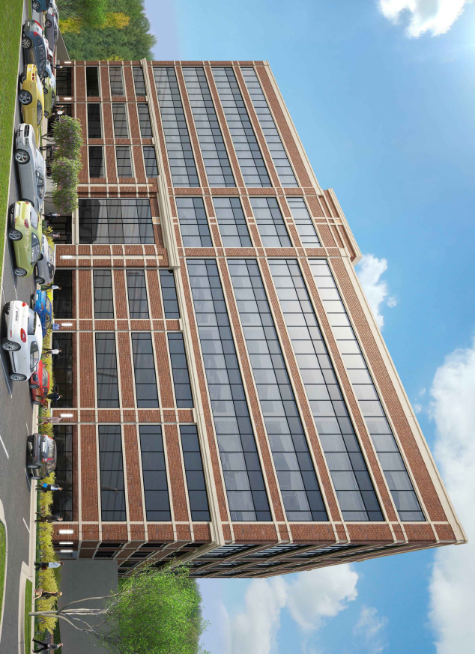
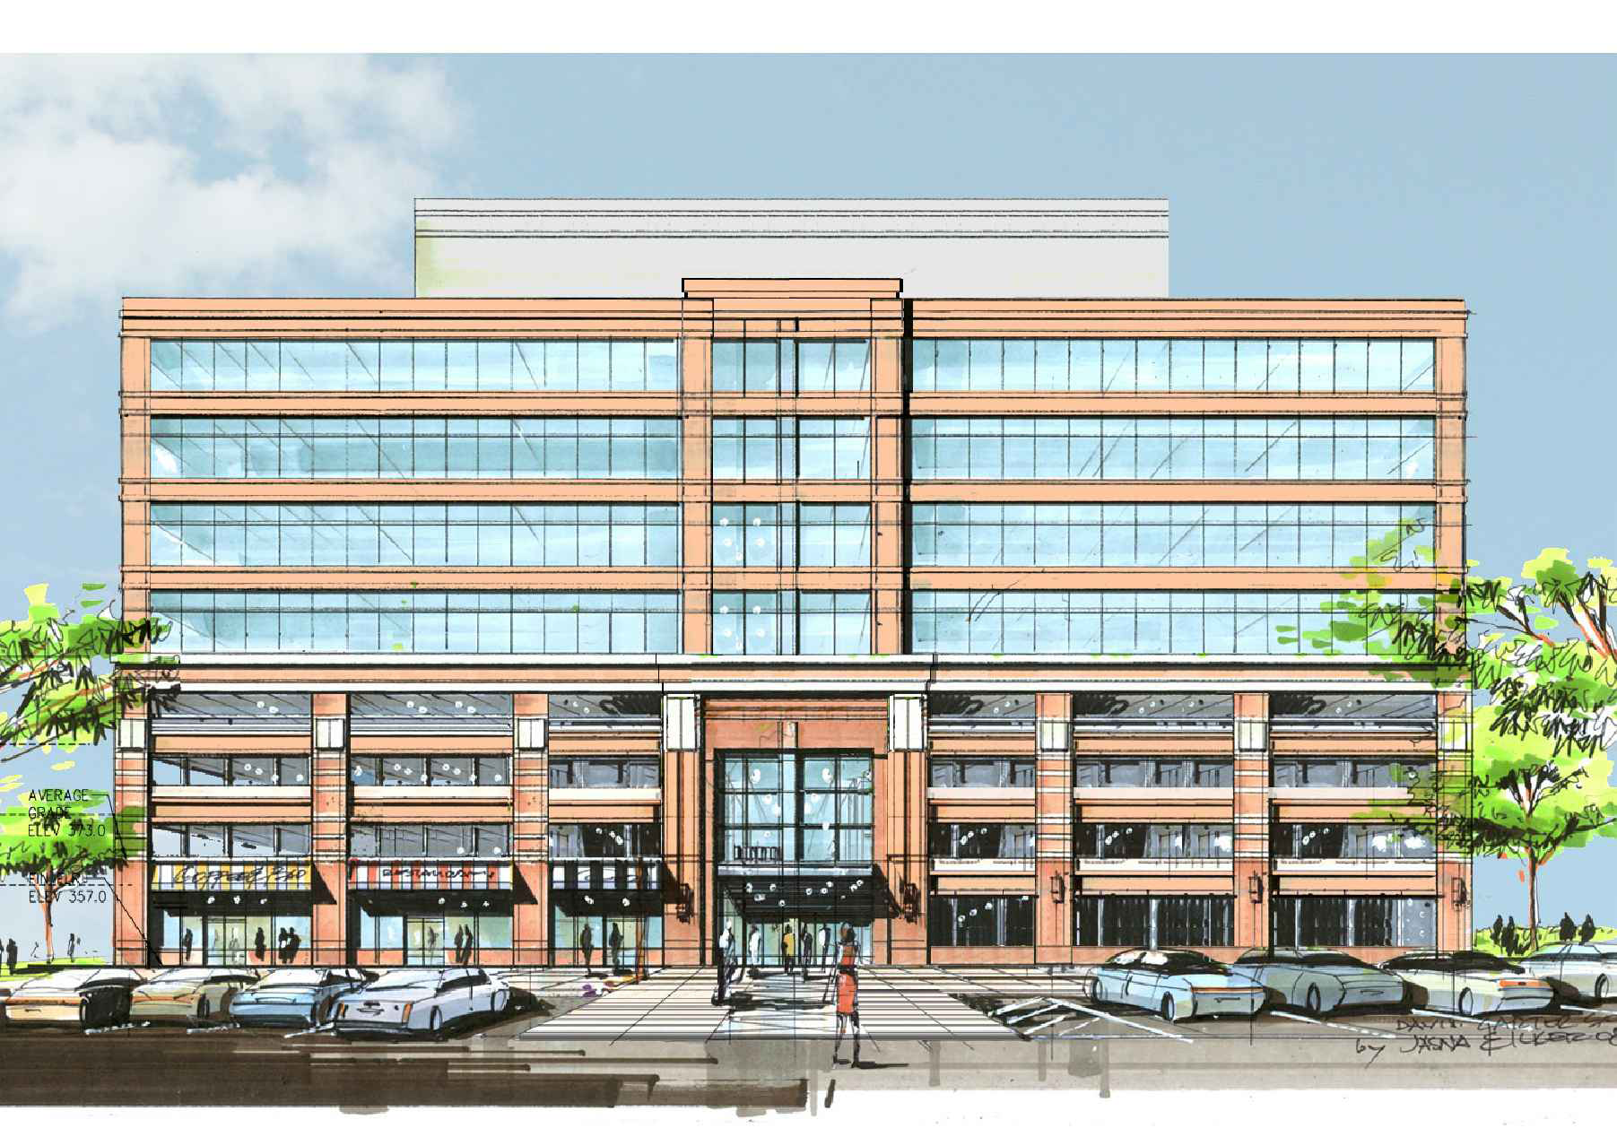
Kingstowne Section 36A Office Building with Parking Garage
Fairfax County, VA
James Chavanic
Structural
PSU AE Senior Thesis
April 8, 2013
Image Provided By DCS Design
Image Provided By DCS Design

Slide 2
PRESENTATION OUTLINE
BUILDING INTRODUCTION
EXISTING STRUCTURE
THESIS PROPOSAL
STRUCTURAL DEPTH
BREADTH 1: SITE REDESIGN
BREADTH 2: FAÇADE REDESIGN (GLAZING)
RESULTS
QUESTIONS
Image Provided By DCS Design
Image Provided By DCS Design

Slide 3
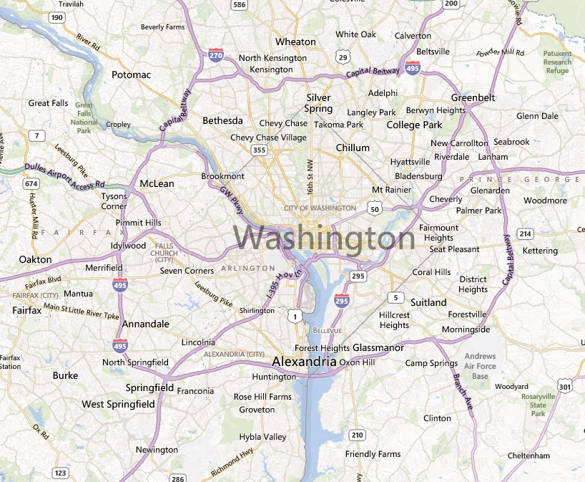
PRESENTATION OUTLINE
PROJECT INFORMATION
BUILDING OVERVIEW
200,000 SF
8 Stories (4 Parking, 4 Office)
Height = 101’-2” (86’-11” from Avg. Grade)
$ 19 Million
Construction: February 2012 – May 2013
BUILDING INTRODUCTION
EXISTING STRUCTURE
THESIS PROPOSAL
STRUCTURAL DEPTH
BREADTH 1: SITE REDESIGN
BREADTH 2: FAÇADE REDESIGN (GLAZING)
RESULTS
QUESTIONS
PROJECT TEAM
Owner: Halle Companies
Architect: Davis, Carter, Scott Ltd. (DCS Design)
GC: L.F. Jennings Inc.
Civil Eng.: Tri-Tek Engineering
Mech. Eng.: Jordan & Skala Engineers
Struct. Eng.: Cagley & Associates
Image From Bing Maps

Slide 4
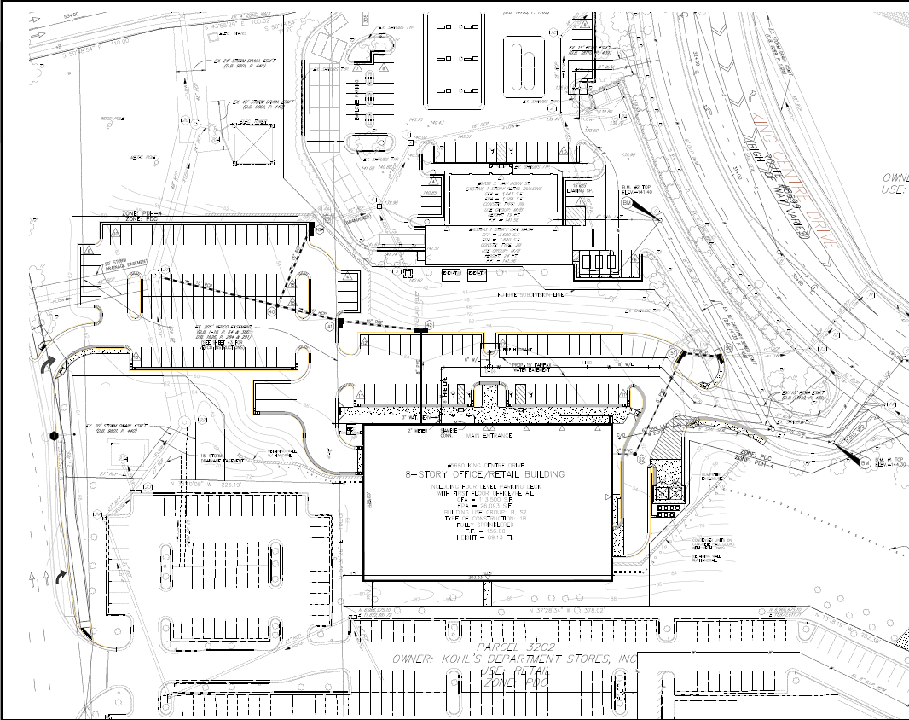
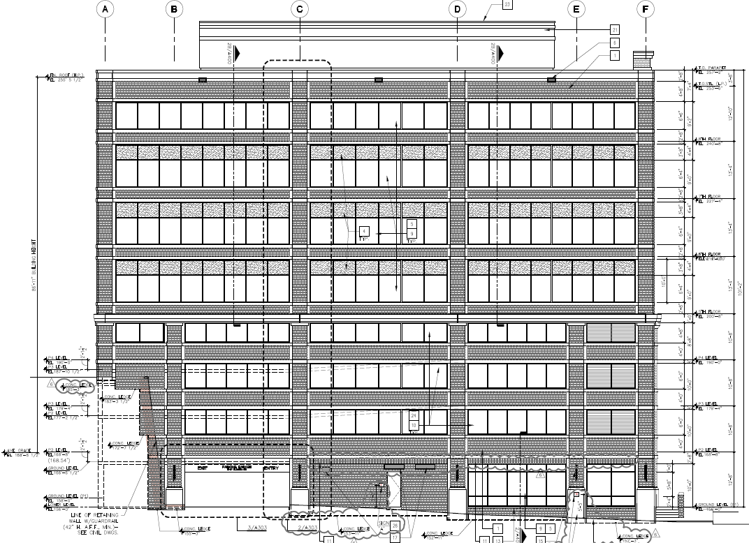
PRESENTATION OUTLINE
SITE RELATIONSHIP
N
BUILDING INTRODUCTION
EXISTING STRUCTURE
THESIS PROPOSAL
STRUCTURAL DEPTH
BREADTH 1: SITE REDESIGN
BREADTH 2: FAÇADE REDESIGN (GLAZING)
RESULTS
QUESTIONS
27’ Difference
Original Images: DCS Design

Slide 5
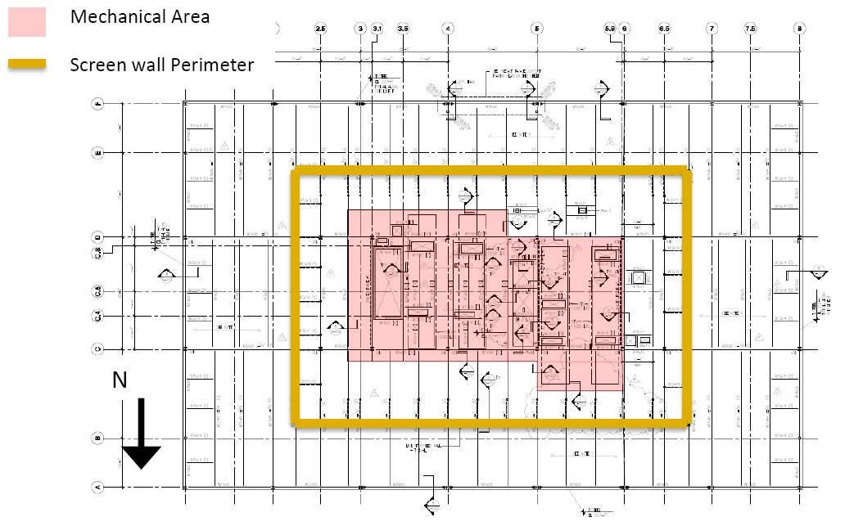
PRESENTATION OUTLINE
EXISTING STRUCTURE
ROOF
3.25” LW Concrete on 2” 18 GA Composite Deck (Mech. Areas)
3” x 20 GA Type N Roof Deck (Remaining Areas)
Spans
A-C 45’-0” , C-D 36’-6” , D-F 43’-6”
East West Direction 28’-6”
Composite action in mechanical areas
(4) 17,000 lb. Roof-top Mechanical Units
BUILDING INTRODUCTION
EXISTING STRUCTURE
THESIS PROPOSAL
STRUCTURAL DEPTH
BREADTH 1: SITE REDESIGN
BREADTH 2: FAÇADE REDESIGN (GLAZING)
RESULTS
QUESTIONS
Original Image: Cagley & Associates

Slide 6
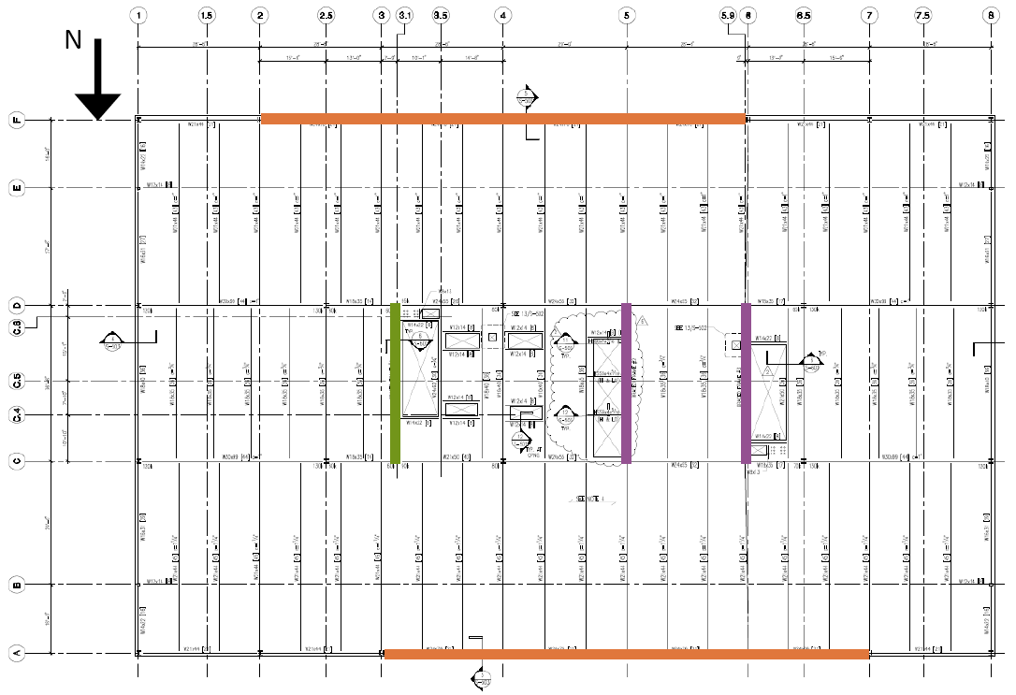
PRESENTATION OUTLINE
EXISTING STRUCTURE
OFFICE LEVELS 2 THROUGH 4
2” x 18 GA Composite Deck
3.25” LW Concrete Topping (3000 psi)
Spans
A-C 45’-0” , C-D 36’-6” , D-F 43’-6”
East West Direction 28’-6”
Composite action beams and girders
13’-4” Floor to floor height
Lateral System
Moment Frames
Concentrically Braced Frames
Eccentrically Braced Frames
BUILDING INTRODUCTION
EXISTING STRUCTURE
THESIS PROPOSAL
STRUCTURAL DEPTH
BREADTH 1: SITE REDESIGN
BREADTH 2: FAÇADE REDESIGN (GLAZING)
RESULTS
QUESTIONS
Original Image: Cagley & Associates

Slide 7
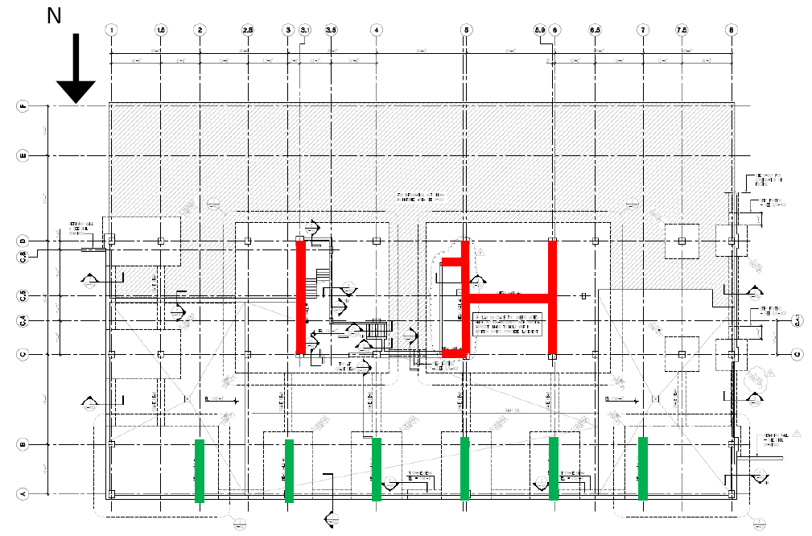
PRESENTATION OUTLINE
EXISTING STRUCTURE
PARKING LEVELS AND OL1
8” Thick concrete flat slab
#4 @ 12” O.C. Bottom Mat
f’_{c} = 5000 psi
Typical bay is 28’-6” x 29’-0”
24” x 24” Typical columns
10-8” Floor to floor height
Lateral System
12 Shear walls
12” Thick
f’_{c} = 5000 psi
#5 @ 12” O.C. Typical E.F.
BUILDING INTRODUCTION
EXISTING STRUCTURE
THESIS PROPOSAL
STRUCTURAL DEPTH
BREADTH 1: SITE REDESIGN
BREADTH 2: FAÇADE REDESIGN (GLAZING)
RESULTS
QUESTIONS
Original Image: Cagley & Associates

Slide 8
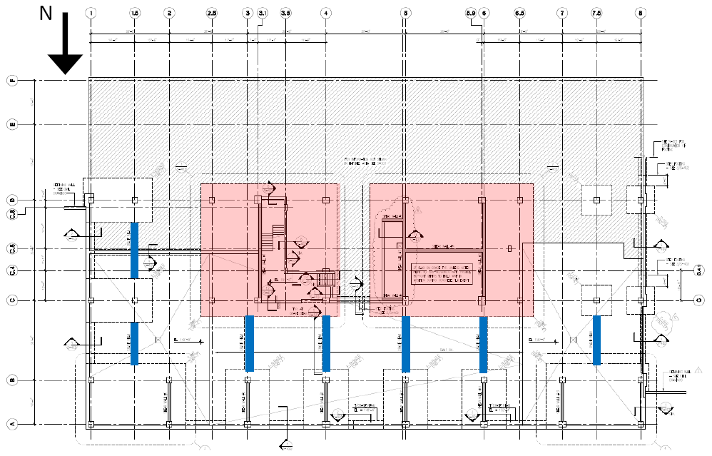
PRESENTATION OUTLINE
EXISTING STRUCTURE
FOUNDATION
All Concrete f’c = 3000 psi
48” Thick concrete mat foundations
Spread Footings
7000 psi bearing capacity
8’ x 8’ to 16’ x 24’
Strip Footings
2500 psi bearing capacity
Geopiers (Rammed Aggregate Piers)
30” Dia. 16’ deep
100 k capacity each
BUILDING INTRODUCTION
EXISTING STRUCTURE
THESIS PROPOSAL
STRUCTURAL DEPTH
BREADTH 1: SITE REDESIGN
BREADTH 2: FAÇADE REDESIGN (GLAZING)
RESULTS
QUESTIONS
Original Image: Cagley & Associates

Slide 9
PRESENTATION OUTLINE
PROPOSED WORK
SETTING THE STAGE
Currently, no tenant selected
Police / Emergency services for Fairfax County, VA
Risk Category IV (Originally Category II)
U.S. Department of Defense Standards
BUILDING INTRODUCTION
EXISTING STRUCTURE
THESIS PROPOSAL
STRUCTURAL DEPTH
BREADTH 1: SITE REDESIGN
BREADTH 2: FAÇADE REDESIGN (GLAZING)
RESULTS
QUESTIONS
www.defense.gov
www.asce.org
www.gsa.gov

Slide 10
PRESENTATION OUTLINE
PROPOSED WORK
BREADTH 1: SITE REDESIGN
Assess potential security issues
Goal
Reduce risks to human occupants
STRUCTURAL DEPTH
Reinforced concrete
Maintain flat slab system
Gravity Design
Use designed OL1 for OL2 - OL4
Design edge beams
Design roof structure
Lateral Design
Ordinarily reinforced concrete shear walls
Progressive Collapse Design
Satisfy requirements adopted by the U.S. Dept. of Defense
Goals
Reduce cost of structural system
Simplify construction
BUILDING INTRODUCTION
EXISTING STRUCTURE
THESIS PROPOSAL
STRUCTURAL DEPTH
BREADTH 1: SITE REDESIGN
BREADTH 2: FAÇADE REDESIGN (GLAZING)
RESULTS
QUESTIONS
BREADTH 2: FACADE REDESIGN
Design glazing for worst scenario from site redesign
Goals
Protect occupants of the building
Maintain thermal performance
MAE REQUIREMENTS
AE 530 – Computer Modeling of Building Structures
AE 538 – Earthquake Engineering
AE 542 – Building Enclosure Science and Design

Slide 11
PRESENTATION OUTLINE
GRAVITY DESIGN
DESIGN CONSIDERATIONS
Risk Category IV
I_{snow} = 1.2
All Concrete f’_{c} = 5000 psi
Façade Load
Assume 100 psf
Floor to floor height
9’-0” Floor to ceiling
17” Clear space in existing Office structure
Provide 24” below flat slab
8” slab system
Result = 11’-8”
Reduce overall by 7’-8”
GRAVITY SYSTEM
2 – way flat slab
Office levels
Significantly cheaper than existing steel system
Reduces floor-to-floor height
Perimeter edge beams
Creates moment frames
Depth constrained to allowed structure plenum
All columns continued from parking levels through office levels
2 additional column lines
Check strength of existing column designs
Higher loads
BUILDING INTRODUCTION
EXISTING STRUCTURE
THESIS PROPOSAL
STRUCTURAL DEPTH
BREADTH 1: SITE REDESIGN
BREADTH 2: FAÇADE REDESIGN (GLAZING)
RESULTS
QUESTIONS

Slide 12
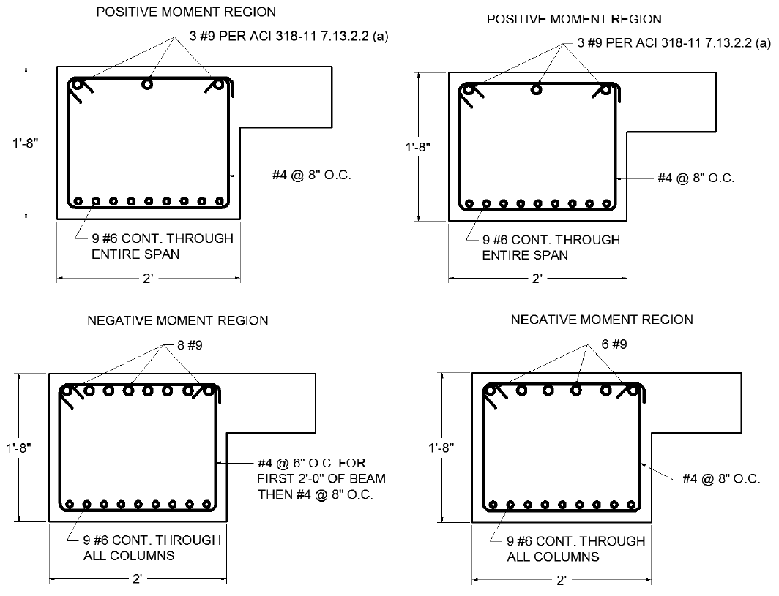
PRESENTATION OUTLINE
GRAVITY DESIGN
DESIGN OF EDGE BEAMS
GSA Design Guide Appendix B.3
2(DL + 0.5L)
9’-0” Tributary Width
20” Trial Depth (2.5*h)
Gives sufficient beam/slab ratio
ACI Moment Coefficients
East – West direction
Frame Analysis
North – South direction
Pattern Loading
BUILDING INTRODUCTION
EXISTING STRUCTURE
THESIS PROPOSAL
STRUCTURAL DEPTH
BREADTH 1: SITE REDESIGN
BREADTH 2: FAÇADE REDESIGN (GLAZING)
RESULTS
QUESTIONS

Slide 13
PRESENTATION OUTLINE
GRAVITY DESIGN
DESIGN/CHECK OF COLUMNS
GSA Design Guide Appendix B.3
2(DL + 0.5L)
Live load reduction considered
Spliced at OL1
“Check” below
“Design” above
Unbalanced moment from slabs
Spreadsheet
Typical columns
Highest load columns
Typically 129% of Original A_{s}
BUILDING INTRODUCTION
EXISTING STRUCTURE
THESIS PROPOSAL
STRUCTURAL DEPTH
BREADTH 1: SITE REDESIGN
BREADTH 2: FAÇADE REDESIGN (GLAZING)
RESULTS
QUESTIONS

Slide 14
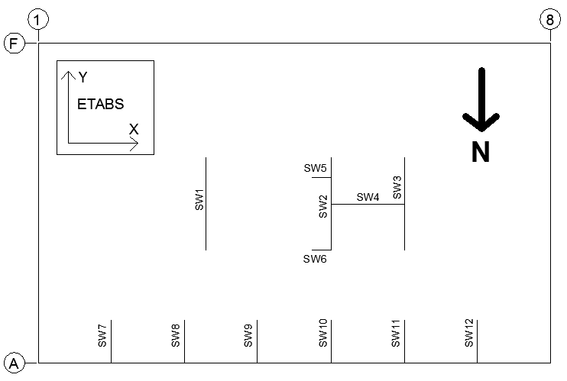
PRESENTATION OUTLINE
LATERAL DESIGN
SOIL LOAD
BUILDING INTRODUCTION
EXISTING STRUCTURE
THESIS PROPOSAL
STRUCTURAL DEPTH
BREADTH 1: SITE REDESIGN
BREADTH 2: FAÇADE REDESIGN (GLAZING)
RESULTS
QUESTIONS
WIND LOAD
120 MPH (Cat. IV)
Exposure B
GC_{pi}
Office = 0.18
Parking = 0.55
Cont. Base Shear
765 k
North Blowing
SEISMIC LOAD
Site Class = D
I_{seismic} = 1.5
SDC = C
R = 5 (ORC Walls)
C_{s} = 0.0249
Weight = 39,017 k
Base Shear
972 k

Slide 15
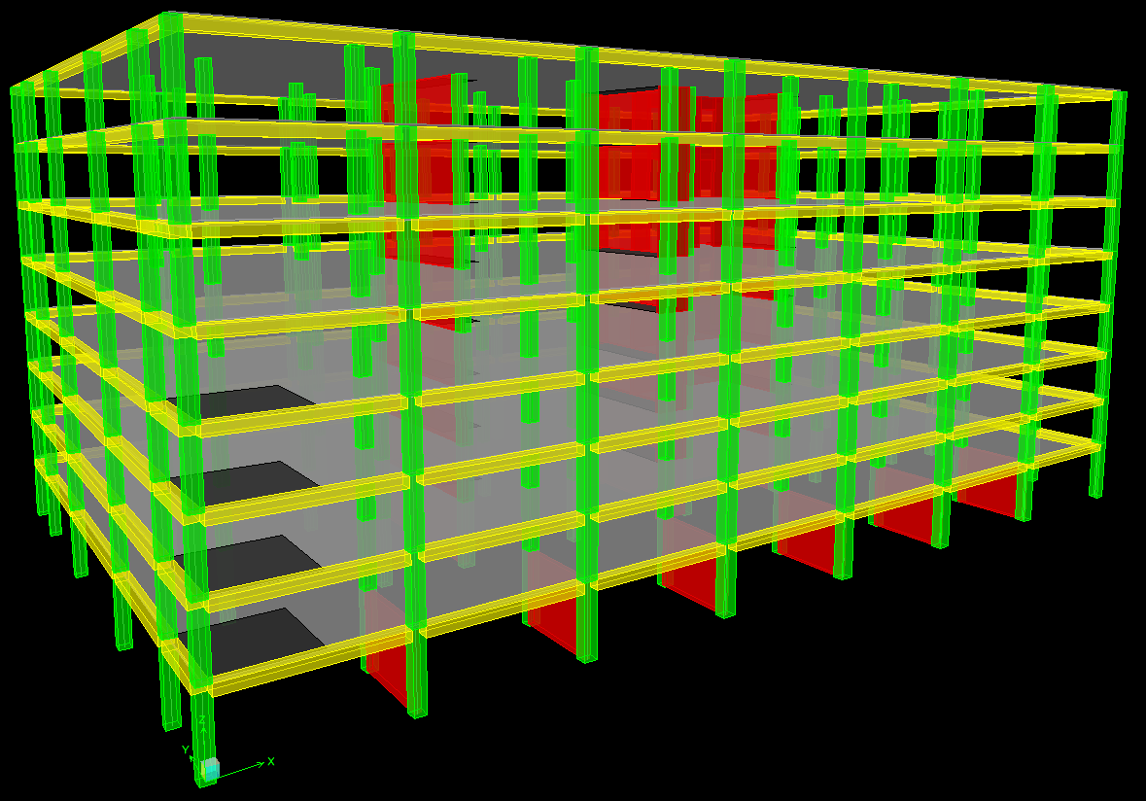
PRESENTATION OUTLINE
LATERAL DESIGN
ETABS MODEL
All elements modeled
Idealize parking levels
Total height = 91’-4”
Effects of cracked sections
Rigid diaphragms
Columns in-line with walls
Walls
Membrane elements
18” x 18” maximum mesh
Seismic loads control
Extreme torsional irregularity N-S direction
BUILDING INTRODUCTION
EXISTING STRUCTURE
THESIS PROPOSAL
STRUCTURAL DEPTH
BREADTH 1: SITE REDESIGN
BREADTH 2: FAÇADE REDESIGN (GLAZING)
RESULTS
QUESTIONS

Slide 16
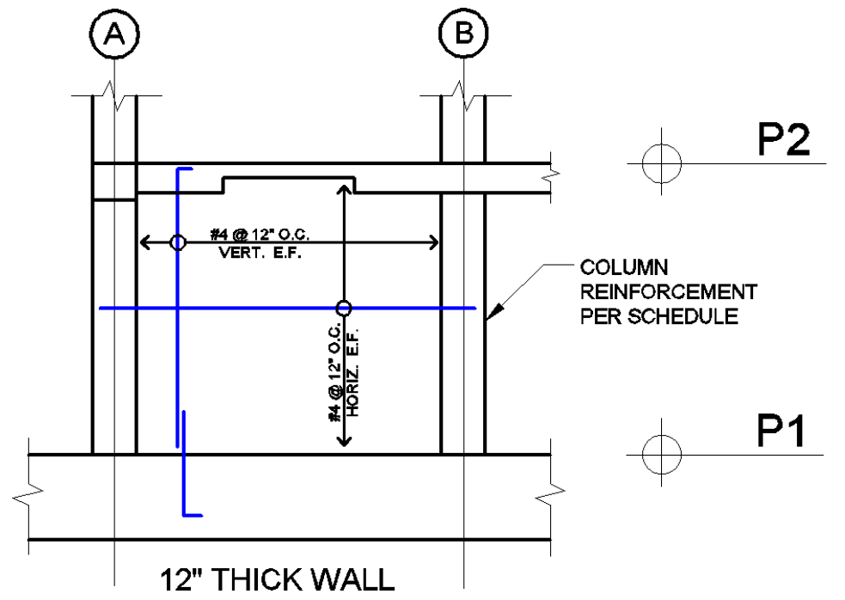
PRESENTATION OUTLINE
LATERAL DESIGN
SHEAR WALL DESIGN
SW7 – SW12 (Same Design)
SW7 Worst Case
Seismic N-S Controls
Primarily Soil Load
SW1 – SW3 (Same Design)
SW1 Worst Case
Seismic N-S Controls
SW5, SW6
Not in scope
SW4
Architectural interference
Seismic E-W Controls
BUILDING INTRODUCTION
EXISTING STRUCTURE
THESIS PROPOSAL
STRUCTURAL DEPTH
BREADTH 1: SITE REDESIGN
BREADTH 2: FAÇADE REDESIGN (GLAZING)
RESULTS
QUESTIONS

Slide 17
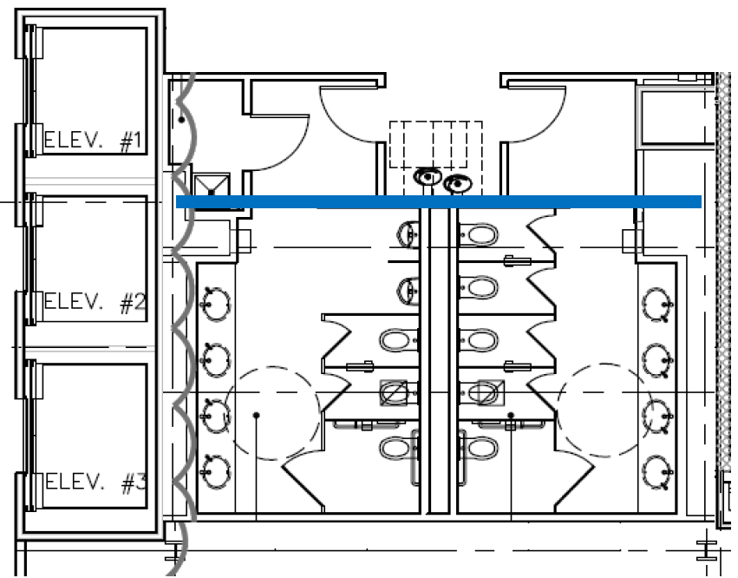
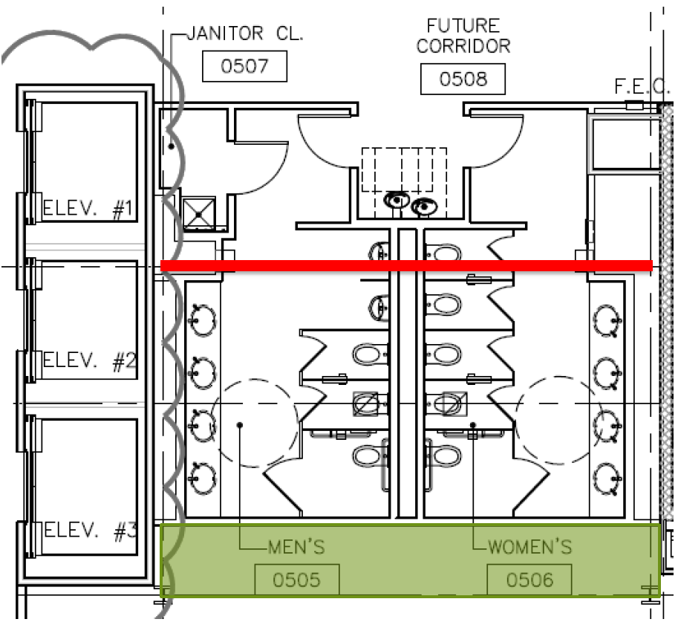
PRESENTATION OUTLINE
LATERAL DESIGN (SW4)
BUILDING INTRODUCTION
EXISTING STRUCTURE
THESIS PROPOSAL
STRUCTURAL DEPTH
BREADTH 1: SITE REDESIGN
BREADTH 2: FAÇADE REDESIGN (GLAZING)
RESULTS
QUESTIONS

Slide 18
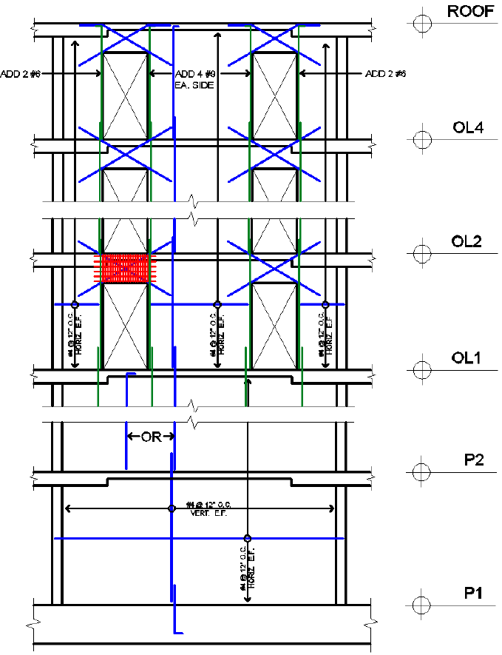
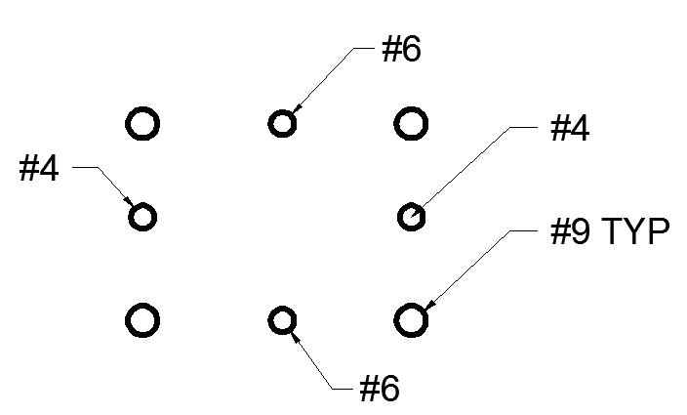
PRESENTATION OUTLINE
LATERAL DESIGN (SW4)
SHEAR WALL DESIGN
Openings
105” Tall
54” Wide
Increased Reinforcement
Coupling Beams
35” Deep
ACI 318-11 21.9.7
Diagonal Reinforcement
Transverse Reinforcement
Tight Curtain
Increase Boundary Reinforcement
Intersection w/ SW2 and SW3
BUILDING INTRODUCTION
EXISTING STRUCTURE
THESIS PROPOSAL
STRUCTURAL DEPTH
BREADTH 1: SITE REDESIGN
BREADTH 2: FAÇADE REDESIGN (GLAZING)
RESULTS
QUESTIONS

Slide 19
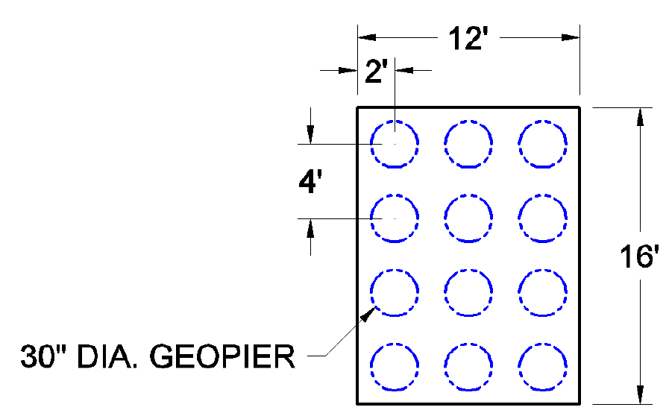
PRESENTATION OUTLINE
FOUNDATION IMPACT
CHECK ON TYPICAL SPREAD FOOTING
Gravity and Lateral Considered
Free Columns
Negligible Lateral Influence
Boundary Columns
High Lateral Influence
Footing at C-1.5 Checked
ASD Combo (D + 0.75L + 0.75S) = 1165 k
11’-0” x 11’-0”
Assuming 9 Geopiers
Results
12’-0” x 16’-0” (58% Inc.)
12 Geopiers (33% Inc.)
BUILDING INTRODUCTION
EXISTING STRUCTURE
THESIS PROPOSAL
STRUCTURAL DEPTH
BREADTH 1: SITE REDESIGN
BREADTH 2: FAÇADE REDESIGN (GLAZING)
RESULTS
QUESTIONS

Slide 20
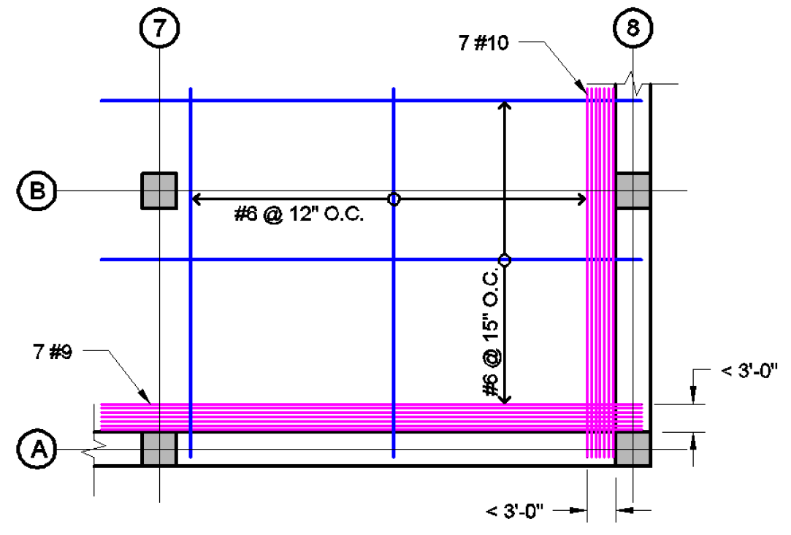
PRESENTATION OUTLINE
PROPRESSIVE COLLAPSE DESIGN
REQUIREMENTS
UFC 4-023-03
Occupancy Category IV
Tie Force Method
Alternative Path Method
Enhanced Local Resistance
BUILDING INTRODUCTION
EXISTING STRUCTURE
THESIS PROPOSAL
STRUCTURAL DEPTH
BREADTH 1: SITE REDESIGN
BREADTH 2: FAÇADE REDESIGN (GLAZING)
RESULTS
QUESTIONS
TIE-FORCE METHOD
φR_{n} = φΩA_{s}F_{y}
Load Combo W_{f} = 1.2D + 0.5L
Internal Ties (3W_{f}L_{i})
Peripheral Ties (6W_{f}L_{i}L_{p})
Vertical Ties (A_{T}W_{f})

Slide 21
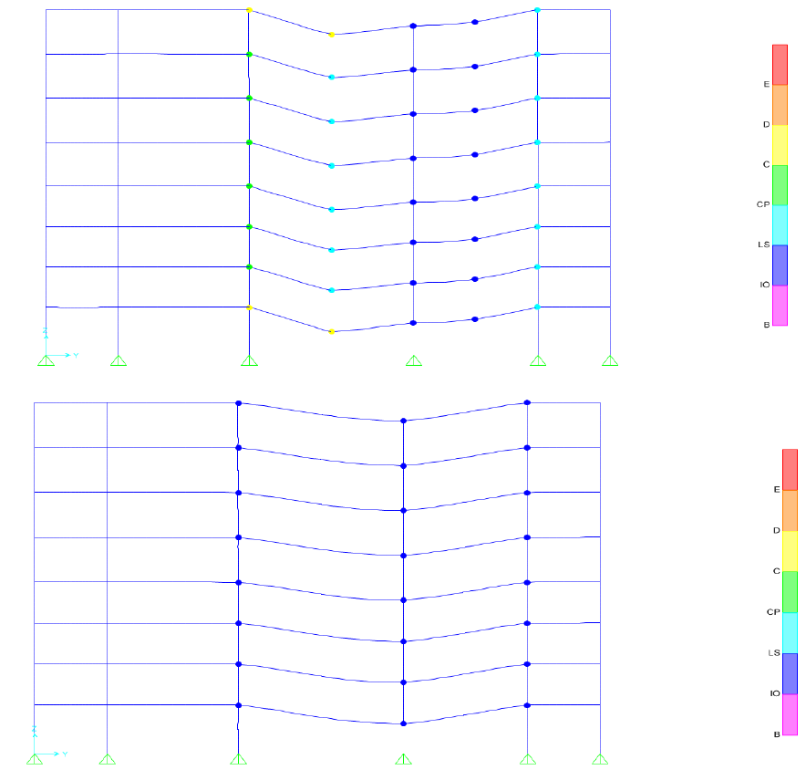
PRESENTATION OUTLINE
PROPRESSIVE COLLAPSE DESIGN
ALTERNATE PATH METHOD
Load Combo [(0.9 or 1.2)D + (0.5L or 0.2S)]
Increase at “Collapse” Bays (x 1.83)
Notional Lateral Load
0.2% of Floor DL
SAP 2000 Model
Hinge Properties Calculated
0.03 Radians (LS)
Cracked Section Properties
Pinned Base Restraints
BUILDING INTRODUCTION
EXISTING STRUCTURE
THESIS PROPOSAL
STRUCTURAL DEPTH
BREADTH 1: SITE REDESIGN
BREADTH 2: FAÇADE REDESIGN (GLAZING)
RESULTS
QUESTIONS

Slide 22
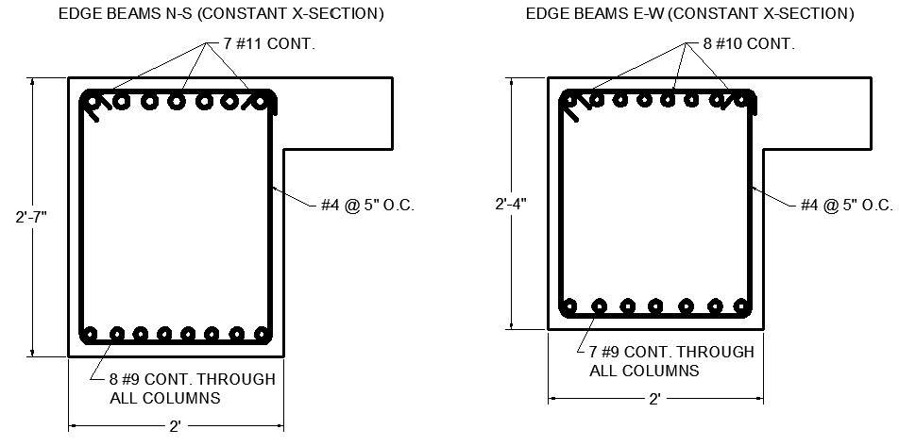
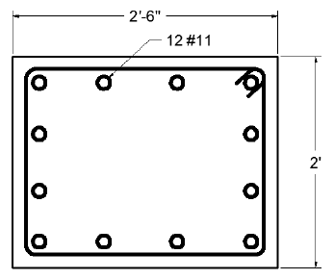
PRESENTATION OUTLINE
PROPRESSIVE COLLAPSE DESIGN
ENHANCED LOCAL RESISTANCE
Occupancy Category IV
First 2 Stories Above Grade
Double Moment Capacity
BUILDING INTRODUCTION
EXISTING STRUCTURE
THESIS PROPOSAL
STRUCTURAL DEPTH
BREADTH 1: SITE REDESIGN
BREADTH 2: FAÇADE REDESIGN (GLAZING)
RESULTS
QUESTIONS
RESULTING DESIGN
31” Deep Beams N – S Direction
28” Deep Beams E – W Direction
Limit Aggregate Size

Slide 23
PRESENTATION OUTLINE
STRUCTURAL DESIGN SUMMARY
COLUMNS
24” x 30” Exterior (12 #11 Bars)
Interior Reinforcement Increases
SLABS
8” Thick Concrete
Typical Bottom Mat
#6 @ 12” O.C. N – S
#6 @ 15” O.C. E – W
BUILDING INTRODUCTION
EXISTING STRUCTURE
THESIS PROPOSAL
STRUCTURAL DEPTH
BREADTH 1: SITE REDESIGN
BREADTH 2: FAÇADE REDESIGN (GLAZING)
RESULTS
QUESTIONS
COST COMPARISON
Existing Structure
$4,127,161
All Concrete Structure
$4,541,898
Difference
$414,737
8% Increase
Progressive collapse design
Edge beams
Result = $448,000 Additional Structure Cost
EDGE BEAMS
Longitudinal Reinforcement
Varies #9, #10, #11
Transverse Reinforcement
#4 @ 5” O.C.
24” Wide
28” – 31” Deep

Slide 24
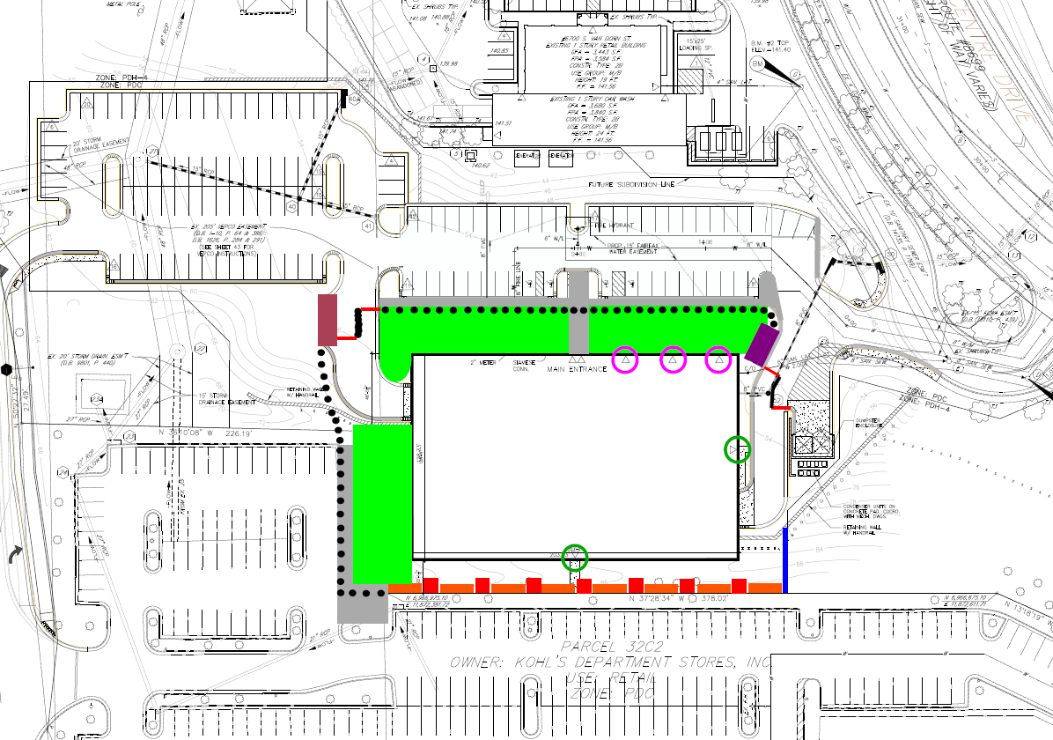
PRESENTATION OUTLINE
N
N
BUILDING INTRODUCTION
EXISTING STRUCTURE
THESIS PROPOSAL
STRUCTURAL DEPTH
BREADTH 1: SITE REDESIGN
BREADTH 2: FAÇADE REDESIGN (GLAZING)
RESULTS
QUESTIONS

Slide 25
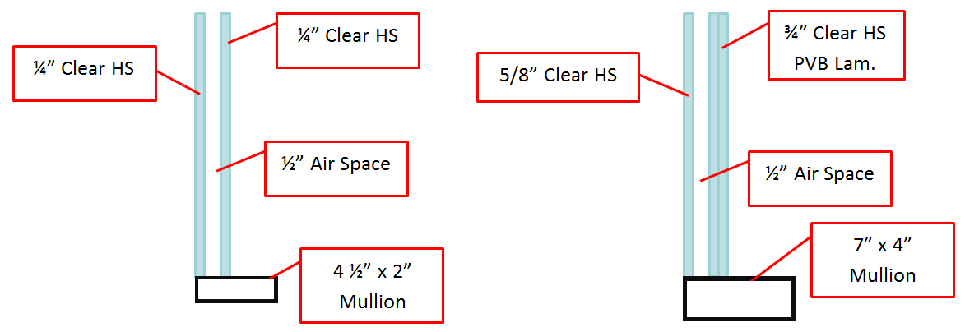
PRESENTATION OUTLINE
GLAZING DESIGN
DESIGN PARAMETERS
35’ Standoff Distance
Small Car Bomb
80 lb. TNT Equivalent
BUILDING INTRODUCTION
EXISTING STRUCTURE
THESIS PROPOSAL
STRUCTURAL DEPTH
BREADTH 1: SITE REDESIGN
BREADTH 2: FAÇADE REDESIGN (GLAZING)
RESULTS
QUESTIONS
DESIGN GUIDES
ASTM F2248-12
Equivalent 3s Blast Load
E1300-12a
Glazing Design Tables
RESULTS
All glass heat strengthened
Occupants Protected
Thermal Performance Not Achieved
More heat gain in summer
More heat gain in winter

Slide 26
PRESENTATION OUTLINE
CONCLUSION
Successful design of structure using reinforced concrete
However, costs $448,000 more
Meets requirements for OC IV Building
Meets requirements of Department of Defense for progressive collapse
Site safety increased, however not ideal
Occupant safety increased
Lost thermal performance
BUILDING INTRODUCTION
EXISTING STRUCTURE
THESIS PROPOSAL
STRUCTURAL DEPTH
BREADTH 1: SITE REDESIGN
BREADTH 2: FAÇADE REDESIGN (GLAZING)
RESULTS
QUESTIONS

Slide 27
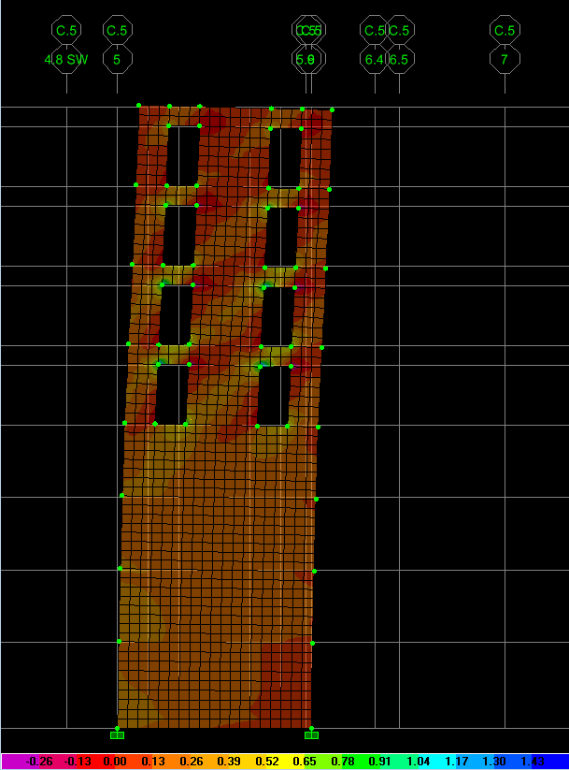
QUESTIONS
ACKNOWLEDGEMENTS
AE Faculty
Dr. Boothby
Dr. Lepage
Professor Parfitt
AE Graduate Students
David Tran
Ryan Solnosky
Cagley & Associates
Frank Malits
Nehemias Iglesias
Halle Companies
Rich Rounds
DCS Design
Carmencita Calong
My family, fiancée, and friends
Image Provided By DCS Design

